Slide 1

Innovate, Collaborate & Accelerate

Slide 2
Index
Docker Pull
Run a container
List all container
Container lifecycle
Additional command

Slide 3
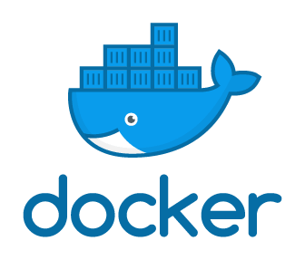
Docker Pull
Try to download the Image from Docker Hub
Docker
Pull
Image Name
Name of Image to download
Reference the Docker client

Slide 4
Docker Pull
Try to download the Image from Docker Hub
Docker
Pull
Image Name
Name of Image to download
Reference the Docker client
docker pull hello-world

Slide 5
Docker Run- To Start new container from image
Image
Running Process
FS Snapshot
Startup Command
Kernal
Hello-World
>Run Hello-World
RAM
CPU
Network
Hello-World
Hard disk Segment of This Process

Slide 6
Docker Run
Try to Create and Run a container
Docker
Run
Image Name
Name of Image to use for this container
Reference the Docker client
docker run hello-world

Slide 7
Docker Run
Image
Run Hello-World
Running Process
FS Snapshot
Startup Command
Kernal
Hello-World
>Run Hello-World
RAM
CPU
Network
Hello-World
Hard disk Segment of This Process

Slide 8
Docker Run Command Override
Try to Create and Run a container
Default Command Override
Docker
Run
Image Name
Command
Name of Image to use for this container
Reference the Docker client
docker run busybox echo hi techpledge

Slide 9
Docker Run
Image
Echo
Running Process
FS Snapshot
Startup Command
Kernal
Bin
Dev
etc
?????
Home
Proc
root
RAM
CPU
Network
Bin
Dev
etc
Hard disk Segment of This Process
Home
Proc
root

Slide 10
Docker Run Command Override
Try to Create and Run a container
Default Command Override
Docker
Run
Image Name
Command
Name of Image to use for this container
Reference the Docker client
docker run busybox ls

Slide 11
Docker Run
Image
ls
Running Process
FS Snapshot
Startup Command
Kernal
Bin
Dev
etc
?????
Home
Proc
root
RAM
CPU
Network
Bin
Dev
etc
Hard disk Segment of This Process
Home
Proc
root

Slide 12
List All Running Containers
List All Running Ciontainers
Docker
PS
Reference the Docker client
docker ps
docker ps –a

Slide 13
Docker Process
docker run busybox ping google.com
CTRL+C
docker ps
docker ps -a

Slide 14
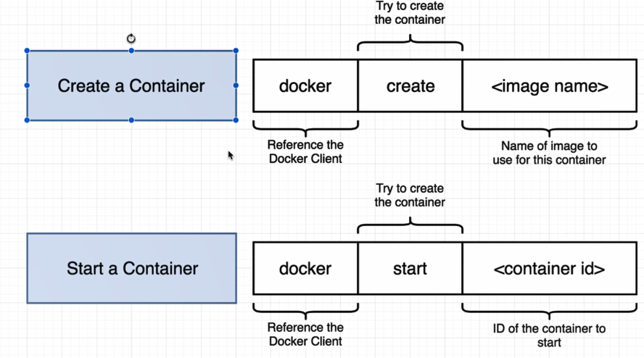
Docker Container Lifecycle
docker run
docker create
docker start

Slide 15
Docker Container Lifecycle
Docker run , actually run the image
Image
ls
Running Process
FS Snapshot
Startup Command
Kernal
Bin
Dev
etc
?????
Home
Proc
root
RAM
CPU
Network
Bin
Dev
etc
Docker create , actually create an snapshot of image in hard disk
Hard disk Segment of This Process
Home
Proc
root

Slide 16
Docker Container Lifecycle
docker create hello-world
docker start -a <container ID>
Docker –a actually print the output from image

Slide 17
Docker Container Lifecycle
docker run busybox hi there
docker ps --all
docker start <container id>
docker start -a <container id>
Docker logs <container id>
Docker system prune
Docker start –a actually print the output from image

Slide 18
Docker Container Lifecycle-Stop Container
Stop a Container
Docker
Stop
Cont ID
Kill a Container
Docker
Kill
Cont ID
docker create busybox ping google.com
docker start <container id>
docker logs <container id>
docker ps
docker stop <container id>
docker ps
docker start <container id>
docker kill <container id>

Slide 19
Execute an additional command in a container
Run another command
Id of the container
Docker
Exec
-it
Container ID
Command
Reference the Docker client
Allow us to provide input to the container
Default Command Override
docker pull ubuntu
docker run -it -d ubuntu
docker ps –a
docker exec –it <containber id> bash

Slide 20
Run a container with primary shell
docker run -it busybox sh

Slide 21
What you Learn?

